Slide 1
Portuguese Banking
Jimmy Blezin

Slide 2
Statement
01
Methodology
02
Function & Objective
03
Feature Importance
04
Model Predictions
05
Future Work

Slide 3
Methodology
UCI: Machine Learning Repository
Logistic Regression
Libraries
Python
Pandas
Scikit-Learn
Seaborn
Tableau

Slide 4
Function & Objective
Direct marketing campaign from a Portuguese financial institution.
Campaigns were conducted via phone calls
Classify if a client will subscribe to a term deposit (i.e CD, Guaranteed Investment Certificate, Bond, etc.)*
*Class Imbalance with target value: leveraged SMOTE Oversampling.
Machine Learning Repo: UCI

Slide 5
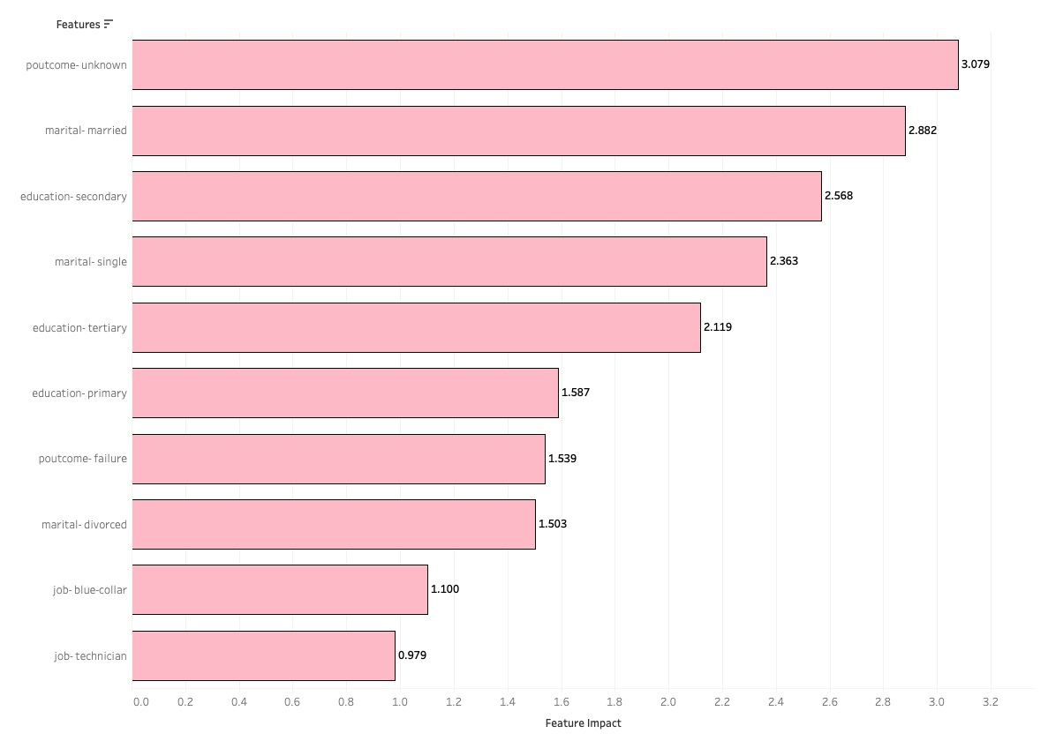
Feature Importance

Slide 6
Model Predictions
Confusion Matrix
Decision Threshold: 0.1
Recall: The model is currently predicting the positive class (Yes) correctly at a ratio of .80
The accuracy ratio of the model is .75
F1 score: .43
Actual Accounts | Yes | 3,402 | 824
 | No | 8,151 | 23,792
 |  | Yes | No
 |  | Predicted Accounts

Slide 7
Future Work
Incorporate Portugal's financial economic climate between 2008 - 2010
Additional data surrounding client’s profile (i.e household income, median salary, etc.)
Develop granular aspect of dashboard

Slide 8
Any Questions?
THANK YOU

Slide 9
Resources:
Github: https://github.com/jblezin/Portuguese_Banking
Tableau Dashboard: https://public.tableau.com/profile/jblezin#!/vizhome/Book1_15965182102290/PortugueseBanking

